Slide 1
SCOPE 2021
A New Scorecard for Osteoporosis
In Europe
Belgium
If sharing data or information from this slide deck, please reference as: Kanis JA, et al. SCOPE 2021: a new scorecard for osteoporosis in Europe, Arch Osteoporos 2021
Data from SCOPE 2021 resources, International Osteoporosis Foundation
https://www.osteoporosis.foundation/scope-2021

Slide 2
A NEW SCORECARD FOR OSTEOPOROSIS IN EU 27+2
REVEALS BURDEN OF DISEASE, GAPS, AND INEQUALITIES IN OSTEOPOROSIS & FRACTURE PREVENTION AND CARE
BELGIUM
681,000
BURDEN OF DISEASE
100,000
CHANGE IN COST PER INDIVIDUAL
INDIVIDUALS WITH OSTEOPOROSIS IN 2019
79.1%
NEW FRAGILITY FRACTURES IN 2019
€98.3
2019
WOMEN
+56%
20.9%
274
FRACTURES
PER DAY
11
FRACTURES
PER HOUR
MEN
€62.9
2010
5.6% OF THE TOTAL POPULATION
€1.1
PROJECTED INCREASE IN THE NUMBER OF
FRAGILITY FRACTURES
SPENT IN 2019
123,000
100,000
2034
€321.9 €766.4 €34.0
BILLION
MILLION
LONG-TERM DISABILITY COSTS
MILLION MILLION
2019
DIRECT COST OF INCIDENT FRACTURES
PHARMACOLOGICAL INTERVENTION
+23%
HUGE COST BURDEN FOR OSTEOPOROSIS-RELATED HEALTHCARE
READ SCOPE 2021 AT
https://www.osteoporosis.foundation/scope-2021
Reference
Willers C et al. Osteoporosis in Europe: A Compendium of country-specific reports. Arch Osteoporosis 2022

Slide 3
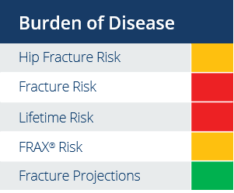
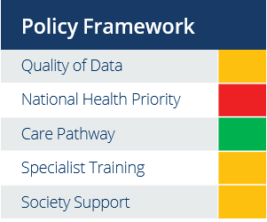
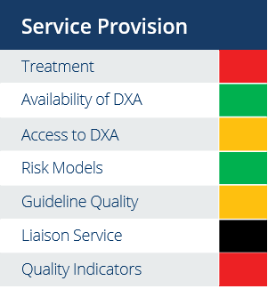
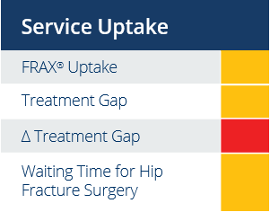
150,000
A NEW SCORECARD FOR OSTEOPOROSIS IN EU 27+2
REVEALS BURDEN OF DISEASE, GAPS, AND INEQUALITIES IN OSTEOPOROSIS & FRACTURE PREVENTION AND CARE
BELGIUM
SERVICE PROVISION & UPTAKE
291,000
WOMEN REMAIN
UNTREATED
FOR OSTEOPOROSIS
61-98% 28.9
WOMEN TREATED
FOR OSTEOPOROSIS
REIMBURSEMENT OF OSTEOPOROSIS MEDICATIONS
AVAILABLE DXA UNITS/MILLION INHABITANTS
2144
€93
FRAX® SESSIONS/ MILLION PEOPLE/YEAR
DXA COST
441,000
WOMEN ELIGIBLE FOR OSTEOPOROSIS TREATMENT
YES
N/A*
66%
FRAX® RISK ASSESSMENT MODEL IS AVAILABLE
OF HOSPITALS HAVING FRACTURE LIAISON SERVICES
TREATMENT GAP
*NO DATA AVAILABLE
POLICY FRAMEWORK
SCORECARD
NO
NO
YES
OTHER SPECIALTIES INVOLVED IN OSTEOPOROSIS CARE
ESTABLISHED NATIONAL FRACTURE REGISTRIES
OSTEOPOROSIS RECOGNISED AS A
SPECIALTY
OSTEOPOROSIS PRIMARILY MANAGED IN PRIMARY CARE
REHABILITATION
*
*no data available
The elements of each domain in each country were scored and coded using a traffic
light system (red, orange, green) and used to synthesise a scorecard.
READ SCOPE 2021 AT
https://www.osteoporosis.foundation/scope-2021
Reference
Willers C et al. Osteoporosis in Europe: A Compendium of country-specific reports. Arch Osteoporosis 2022

